Slide 1

Business
sector
gbif.org/business
Notes:
Notes

Slide 2
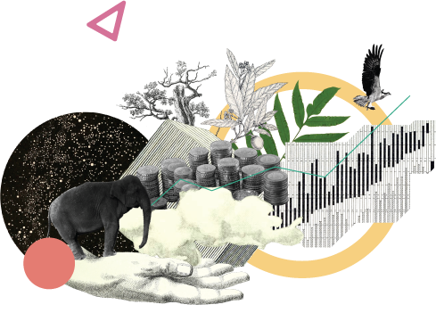
Business sector
Businesses are increasingly demonstrating commitments to environmental and social responsibility by sharing biodiversity data they collect during monitoring and impact assessment activities
gbif.org/business
Notes:
Notes

Slide 3
Business sector
Businesses can both contribute to and benefit from sharing open data on biodiversity. Many companies make use of free and open location-specific data and information through GBIF to support evidence-based decision-making and inform corporate responses to new reporting requirements for biodiversity. Meanwhile, a growing network of private enterprises use GBIF as a platform for sharing data collected during their operations, often closing gaps in global knowledge of biodiversity.
The combined value of these activities helps businesses and financial institutions to reduce biodiversity-related risks and to increase their positive impacts toward Target 15 under the Kunming-Montreal Global Biodiversity Framework.
gbif.org/business

Slide 4
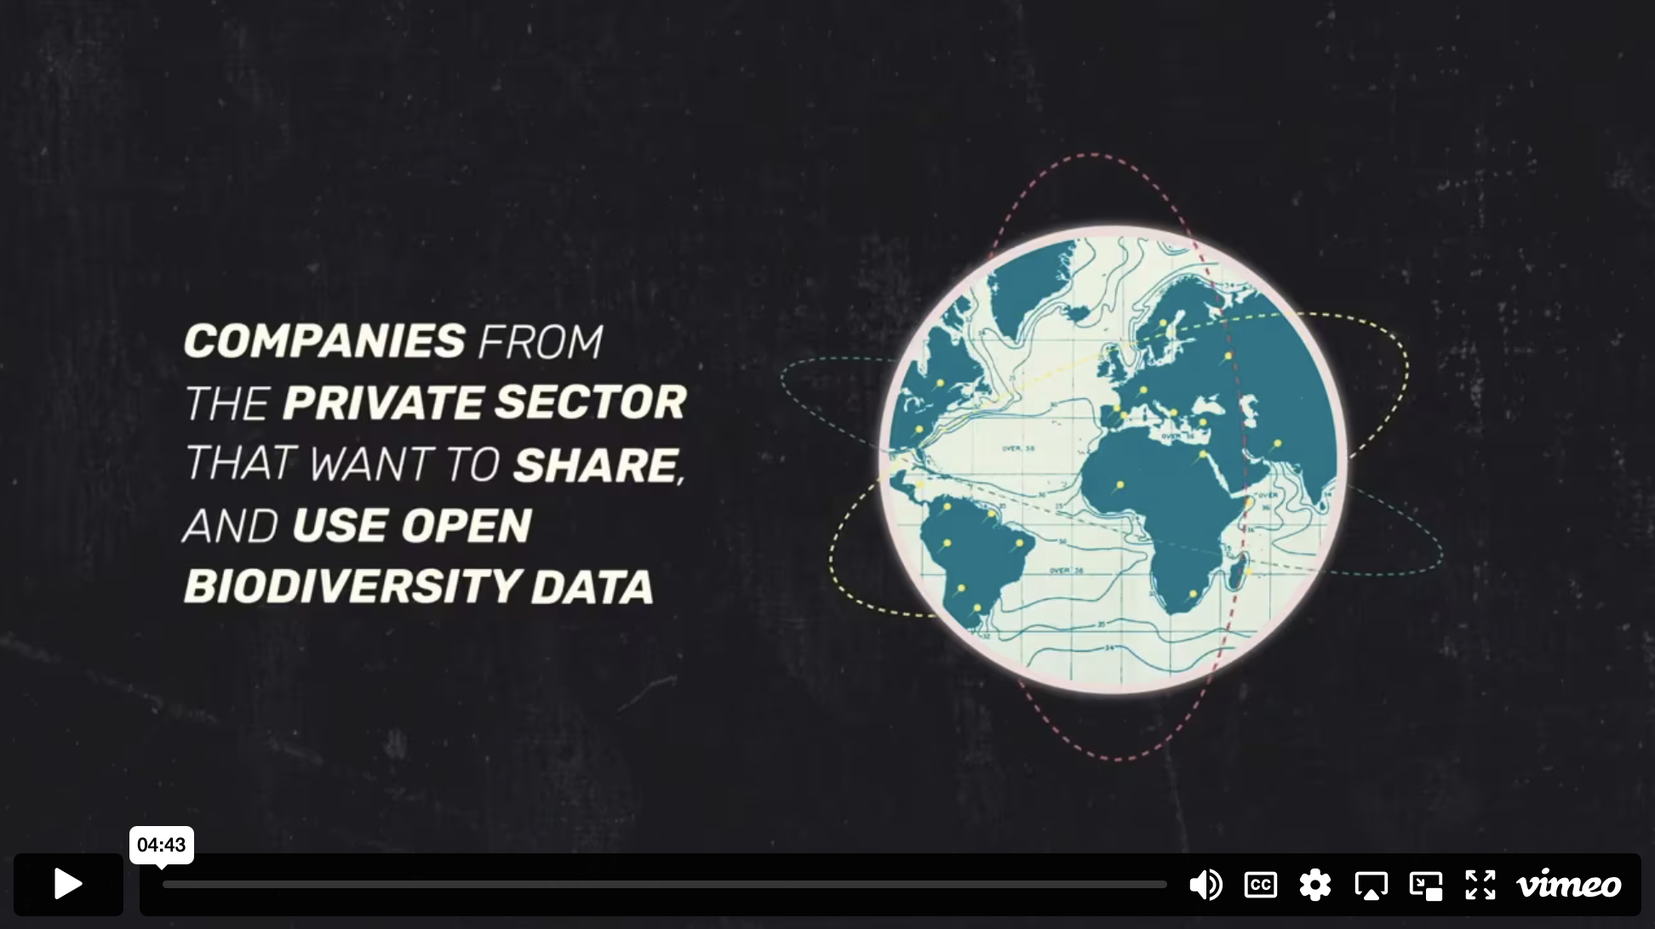
Business sector - Video

Slide 5



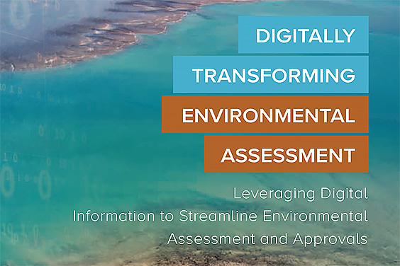
Background and guidance on data sharing from the business sector
Data4Nature: Share to protect
OpenPSD: Promoting publication and use of private-sector data on biodiversity
Guidance for private companies to become data publishers through GBIF
Digitally Transforming Environmental Impact Assessment
gbif.org/business
Notes:
Notes

Slide 6


Featured case studies
Colombia: Biodiversidad y Desarrollo
France: Depobio
gbif.org/business

Slide 7




Featured business-sector publishers
Biofokus
DNV
Ecopetrol S.A.
EDP
gbif.org/business
Notes:
Notes

